Slide 1
Endogenous Zoning: An ABM of the Homevoter Hypothesis
CSS 610
Olivia Gonzalez
Walter Stover

Slide 2
Outline
Background: Housing Affordability Crisis
Overview of the Homevoter Hypothesis
Literature
Model
Results

Slide 3
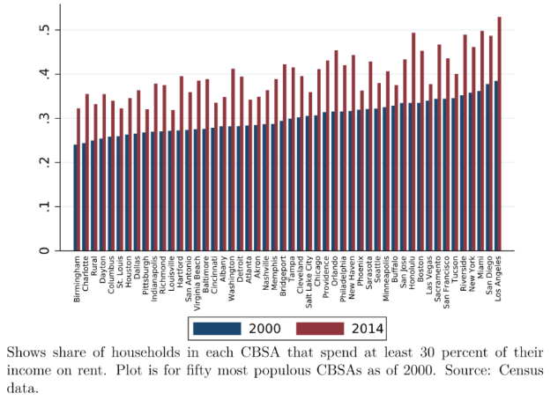
The Affordability Crisis
Anenburg and Kung (2020)

Slide 4
The Affordability Crisis
A measure of housing unaffordability: households that spend more than 30 of their household income on rent.
2000: 29.2 percent of households
2014: 38.7 percent of households
The fraction of cost burdened households is much higher among renters than owners (Molloy 2017).
The renter share of US households has been increasing in recent years and stands near a 50-year high of around 27 percent (Fernald 2017).

Slide 5
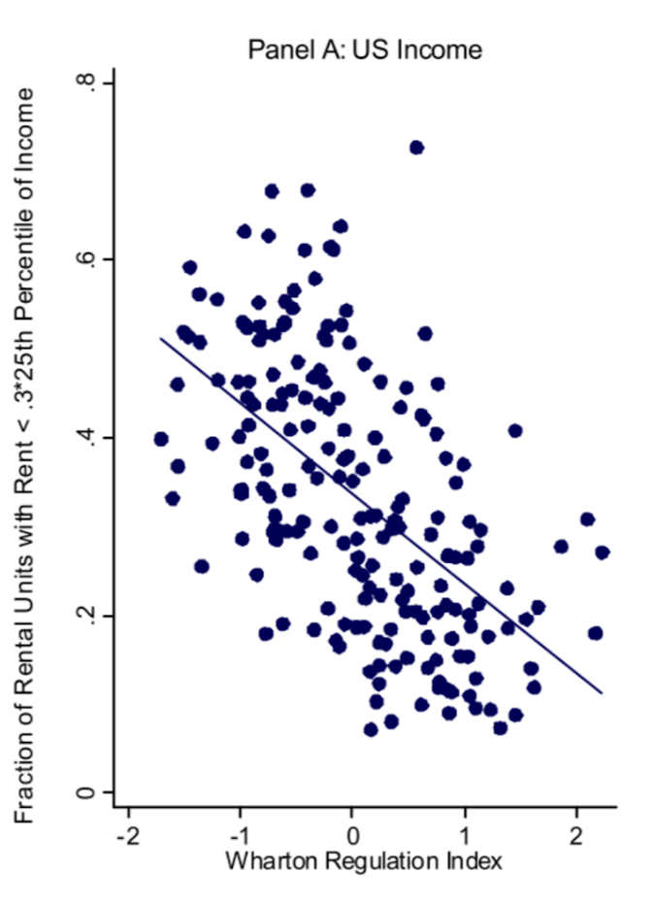
What explains rising housing costs?
Correlation of housing supply regulation and rental affordability (Molloy 2020).
There has been a documented increase in opposition to development and more stringent zoning regulation, on average (Been 2018; Gyourko, Hartley, and Krimmel 2019).

Slide 6
What explains rising housing costs?
There is a consensus within the urban economics literature that zoning regulation increases housing prices and slows down construction/development (Gyourko and Molloy 2014).
Increased ability of local residents to block new projects is prominent driver of urban growth restrictions (Glaeser Gyourko, and Saks 2005a).
There is evidence that regulation is more likely to restrict the supply of multi-family housing than single-family (Shlay and Rossi 1981; Penall 2000).

Slide 7
The Homevoter Hypothesis
Sonsteli and Portney (1978); Fischel (2001)
Homeowners, who are the most numerous and politically influential group within most localities, are guided by their concern for the value of their homes to make political decisions.
Homeowners are acutely aware that local amenities, public services, and taxes are capitalized in the value of their homes. As a result, they pay much closer attention to such policies at the local level than they would at the state or national level.
They balance the benefits of local policies against the costs when the policies affect the value of their home, and they tend to choose those policies that preserve or increase the value of their homes.
Notes:
Fischel (2001): used the term “homevoters” to emphasize that residents who own their own homes have a stake in the outcome of local politics that makes them especially attentive to the public policies of local government

Slide 8
Implications of the Homevoter hypothesis
Homeowners are more likely to get involved with local politics than non-property owners, therefore the interests of the latter may go underrepresented.
Homeowners are more likely to support more stringent zoning codes that make constructing new homes difficult. This is because potential increases in housing supply could lower the value of their homes.
New development that would lower the cost of housing for renters is more difficult to get approved.
Prediction: localities with more homeowners relative to renters are more likely to implement more restrictive zoning policies.

Slide 9
Tests of the Homevoter Hypothesis
Ortalo-Magne and Prat (2014): they develop a theoretical model of an overlapping-generations economy where agents choose where to locate and how much housing to own. City residents vote on the number of new building permits every period.
Location choice model + housing investment model + collective choice model
They endogenize homeownership decisions and housing supply.
City residents invest in housing because they expect their investment to be protected by a majority opposed to urban growth. They vote against growth because they have invested in local housing.
Undersupply of housing persists in equilibrium.
Einstein et al (2019): they provide empirical evidence to support the hypothesis. “Neighborhood defenders” – individuals who oppose new housing projects far more strongly than their broader communities and who are likely to be privileged in a variety of dimensions – participate disproportionately and take advantage of zoning regulations to restrict the construction of multifamily housing.

Slide 10
Why use an ABM?
Despite the consensus on various effects of zoning regulation, there are still concerns about endogeneity in these studies.
Most measures of zoning are cross-sectional; making measuring the dynamics of zoning econometrically very difficult.

Slide 11
Relevant ABMs
Land use ABMs
Magliocca et al (2012) simulate minimum lot size restrictions in an ABM of housing and land markets.
They do not model zoning endogenously, but instead use the ABM to compare temporal and spatial land use outcomes in a baseline, no-zoning scenario to two different zoning scenarios that are typical to those we see in developing regions in the US.
Rule selection ABMs
Tiebout ABMs

Slide 12
Model
Cellular Single Toroidal Grid
One tick = one month
Learning agents: renters and homeowners
Separate payoffs
Rudimentary voting behavior
Stock and flow dynamics
Population entry and exit
Housing stock changes

Slide 13
Research supporting model assumptions
Like Ortalo-Magne and Pratt (2014) and other authors, we focus on permit issuance as proxy for residential growth restrictions. We do not consider regulations pertaining to height or development density in the interest of parsimony.
Demand factor: A population increase of 1% increases the annual permit rate by 0.675% (McDonald and McMillen 2010).
Demand factor: A vacancy rate increase of 1% decreases the annual permit rate by 0.044% (McDonald and McMillen 2010).
Supply factor: Jackson (2016) finds that an additional regulation reduces residential permit issuance by an average of 4% per year.
Homeowners are more likely to be knowledgeable and participate in local politics and the formation of zoning regulation (Trounstine 2020; Yoder 2019).

Slide 14
Grid Features
Development is synonymous with construction
Each developed square has a vacancy timer and an occupancy timer
Vacancy timer ticks down
Occupancy timer ticks up
New buildings/developed squares added through permits
Vacant buildings destroyed each round
Each developed square has a property value that decreases with new construction

Slide 15
Development Features
Property Value initialized from normal distribution using empirical median
Rent follows 2% rule of thumb
Property values decrease with increase in housing stock

Slide 16
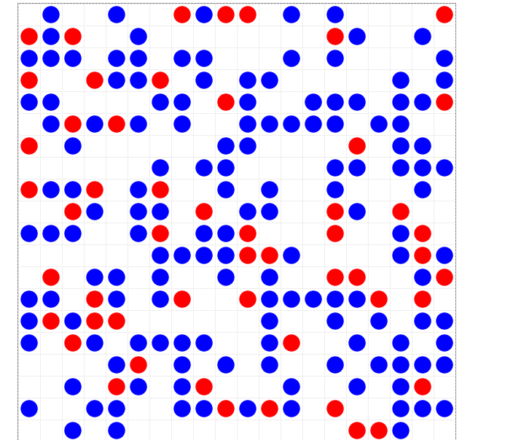
Grid Layout

Slide 17
Agent Behavior
Agents are either homeowners or renters
Enters neighborhood in unoccupied, undeveloped square
Each round, searches Moore neighborhood for developed, ‘affordable’ squares to move into
Affordability based on wealth for homeowners, budget for renters
Moves into nearest affordable square

Slide 18
Agent Behavior (Cont.)
If no affordable squares are present after a certain number of ticks, agent will exit the neighborhood
Must stay in a square a certain number of ticks to ‘occupy’ it
Cannot enter into an occupied square
Once occupied, starts recording their payoffs from that development

Slide 19
Agent Learning Behavior
Homeowner payoff: property value
Renter payoff: budget – rent differential
Each round, remembers their payoff and their vote
If no memory of payoff, vote randomly
Compare running averages of restrictive payoffs and non-restrictive payoffs
Vote for whichever rule is associated with higher payoffs
Memory length of 12, representing full year

Slide 20
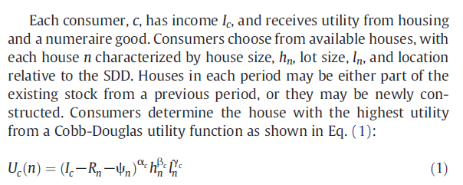

Agent Learning Behavior Cont.)
Magliocca et al. (2012)
Adapted to this model: $U_{r}\left(n\right)=\left(0.02 ∗I_{c} −R_n\right)$
$U_{h}\left(n\right)=\left(I_{c} −R_n\right)$

Slide 21
Committee Voting
Random selection of agents to fill odd number of seats
Each tick, agents vote for restrictive or non-restrictive rules
Restrictive adds one regulation, and vice versa
Number of regulations affects permits issued

Slide 22
Permit Issuance
Regulation level
Population growth rate
Vacancy rate
Directly controls addition of new housing stock

Slide 23
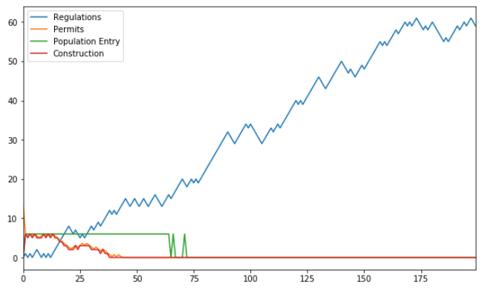
Representative Run, 200 Steps, Homeowners > Renters

Slide 24
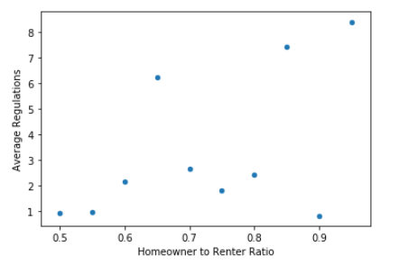
Effect of Homeowner/Renter Ratio

Slide 25
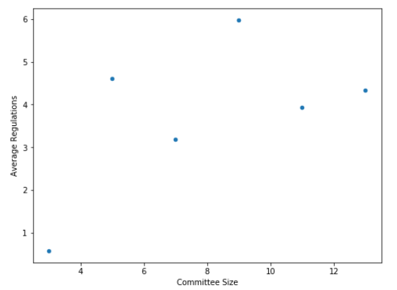
Effect of Committee Size (Ratio = 0.5)
Notes:
Not surprising, given that the selection process is still random

Slide 26
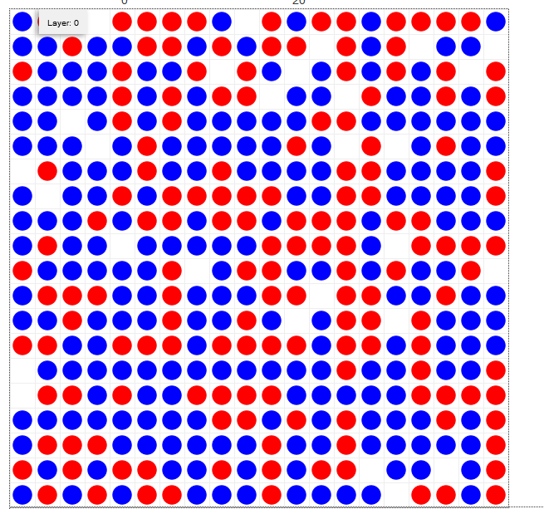
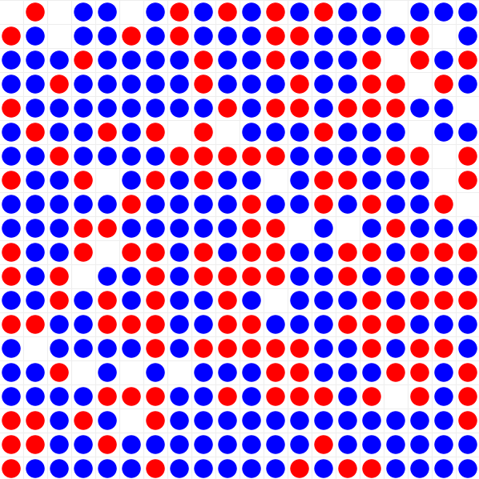
Neighborhood Formation

Slide 27
Results Summary
Rough relationship between homeowner/renter ratio and regulation supply
Limited evidence of neighborhood formation?
Limited evidence of larger investment in rule type on part of homeowners vs. renters
Learning behavior of agents highly sensitive to supply fluctuations

Slide 28
Potential Issues
Fixing noisiness of relationship
Calibrating to empirical relationships
Population dynamics
Regulations keeps climbing indefinitely
Random committee selection may be unrealistic/impair formation of path dependence in results
Assuming neighborhood fully appropriates rights to decide zoning rules
Notes:
Last point comes from the critique by Fischel, I believe, of an earlier work claiming that zoning and other land-use restrictions were used to monopolistically restrict the supply of housing

Slide 29
Wish List
Selection mechanism for agents to committee

Slide 30
Questions?
ogonzal4@gmu.edu
wstover2@gmu.edu

